Slide 1
Developing for Selenium Grid
Dima Kovalenko

Slide 2


Slide 3
What is Selenium Grid?
Distribute
Parallelize
Share resources

Slide 4


Slide 5
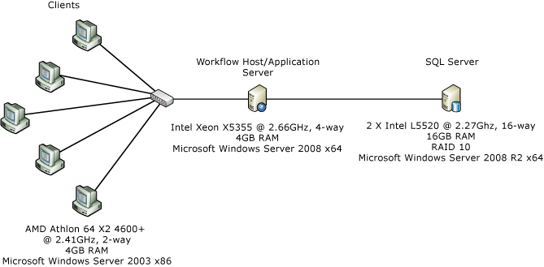
Distribute

Slide 6

Distribute
1 computer vs many

Slide 7
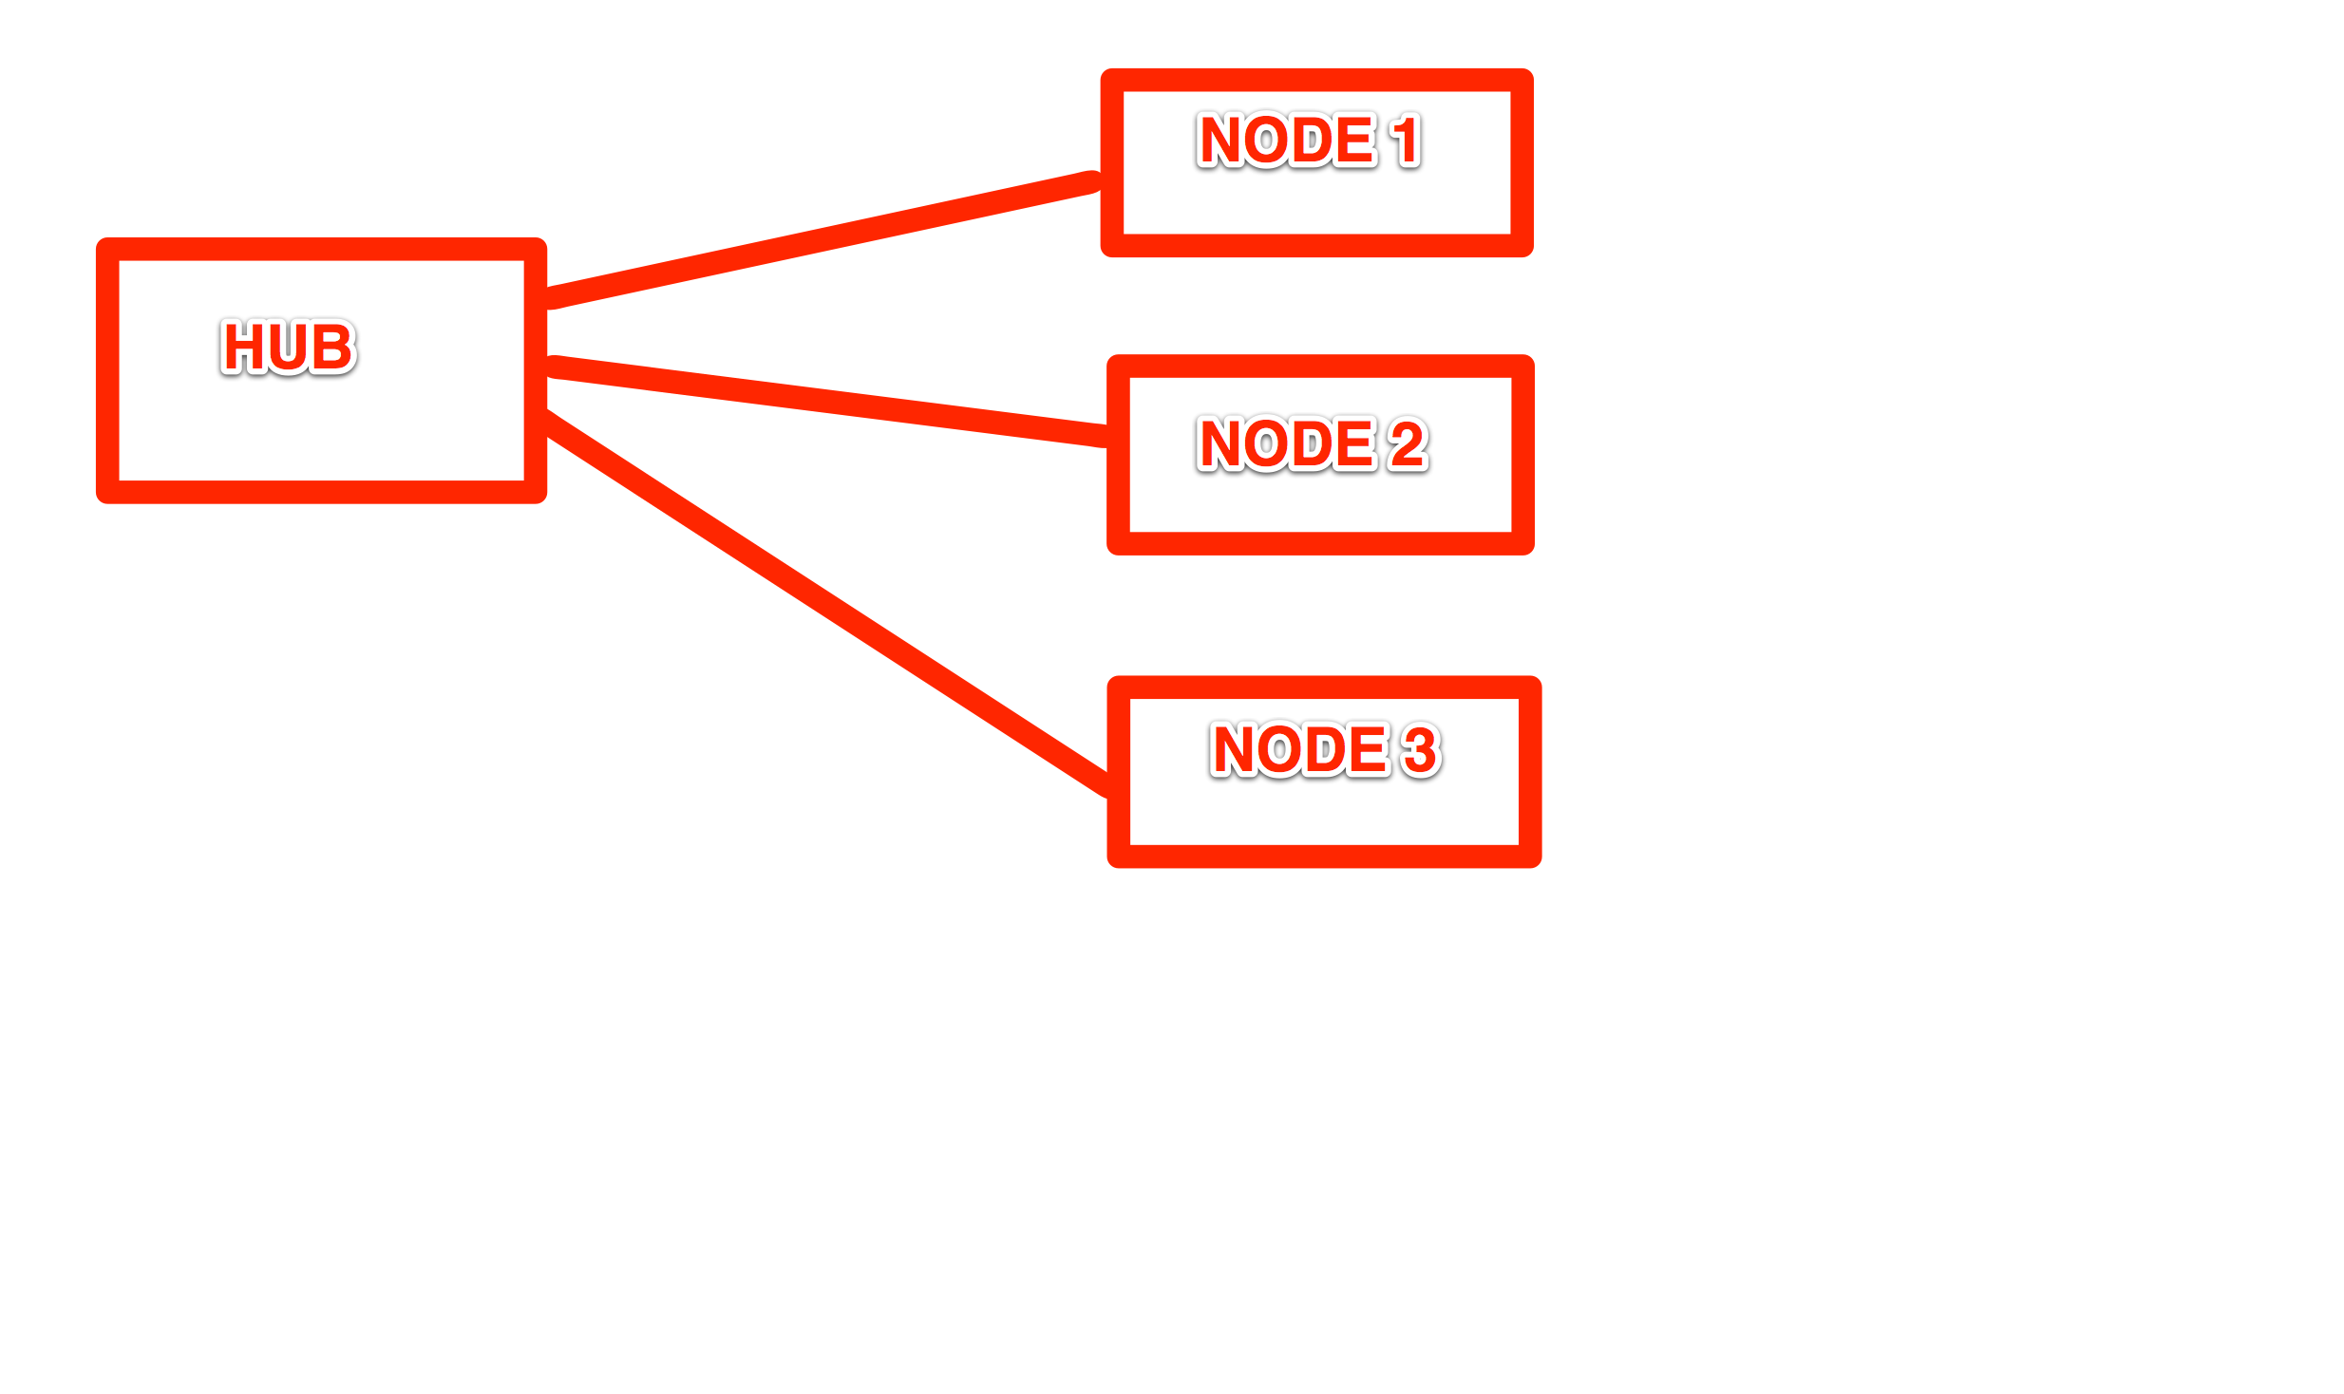

Slide 8
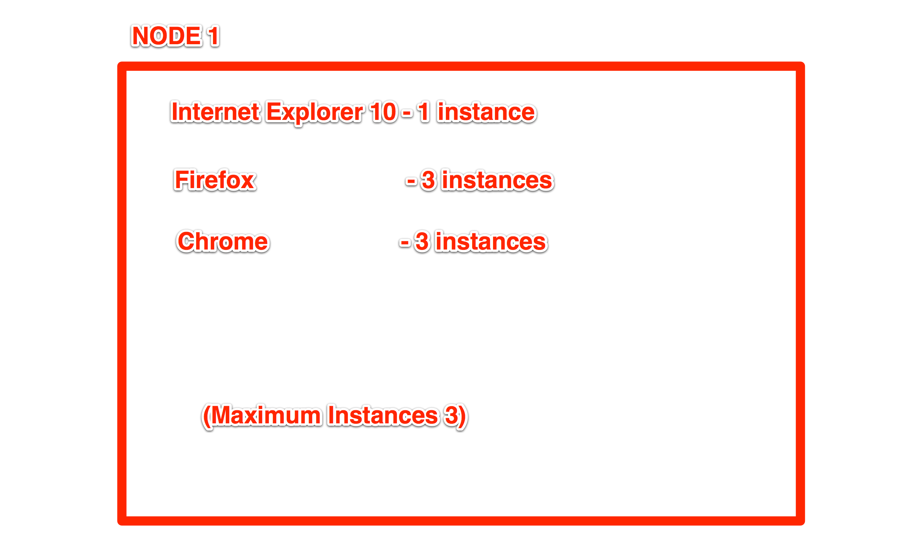

Slide 9
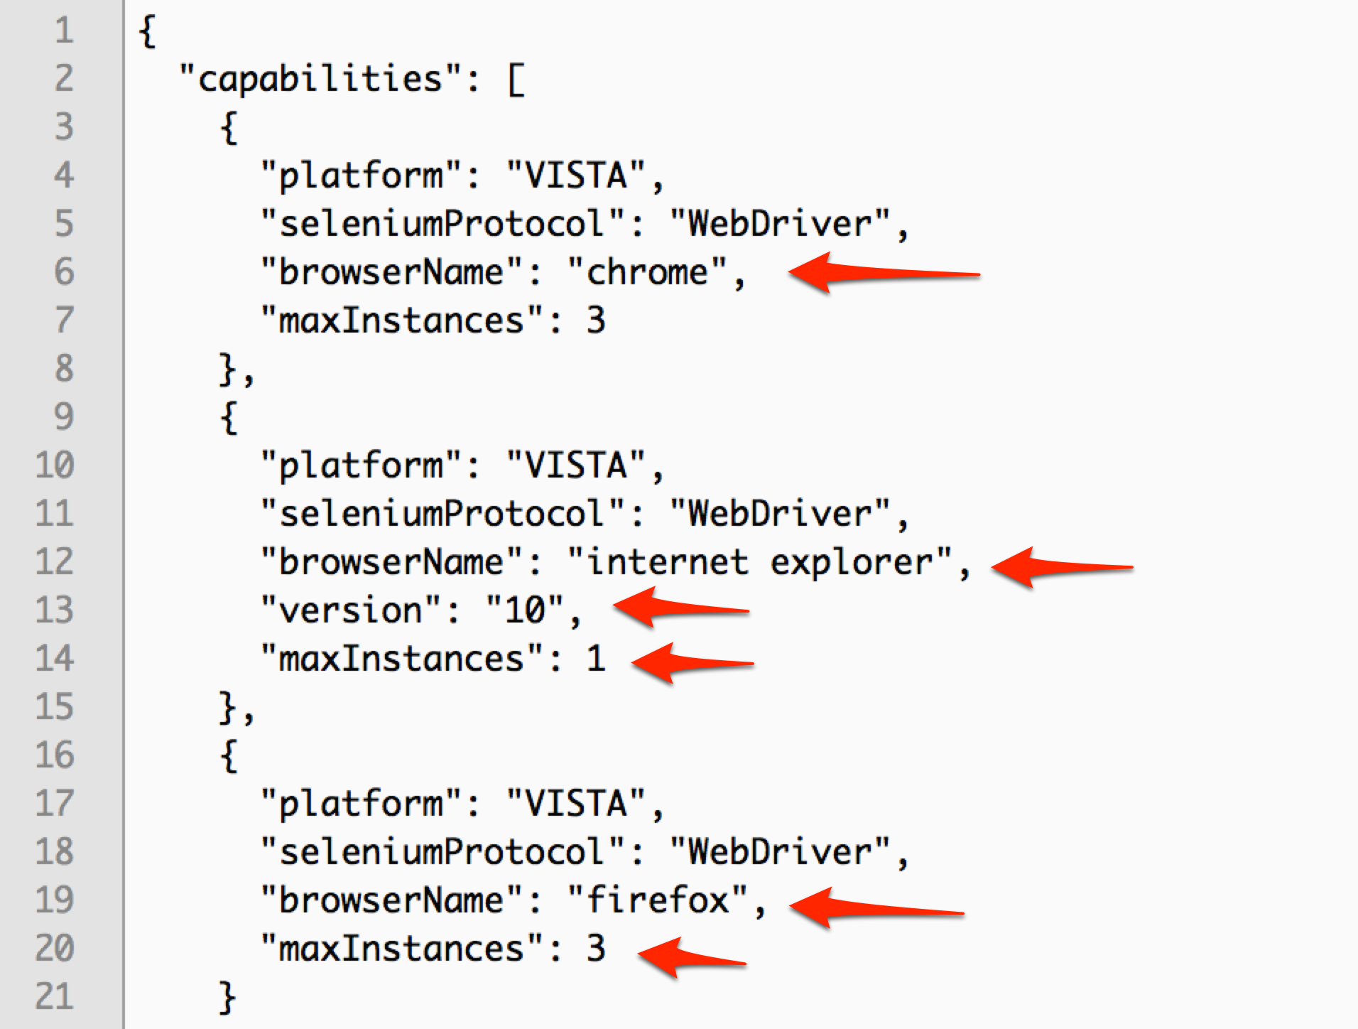
Node Config JSON

Slide 10
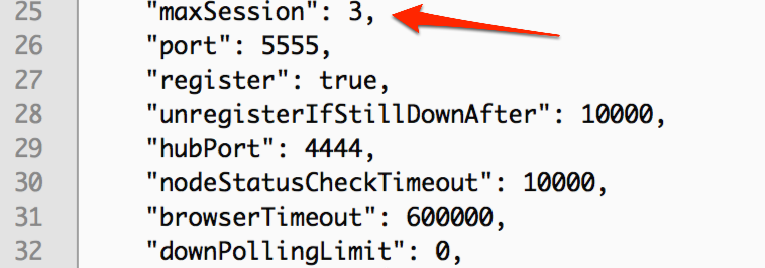

Slide 11

Parallelize

Slide 12
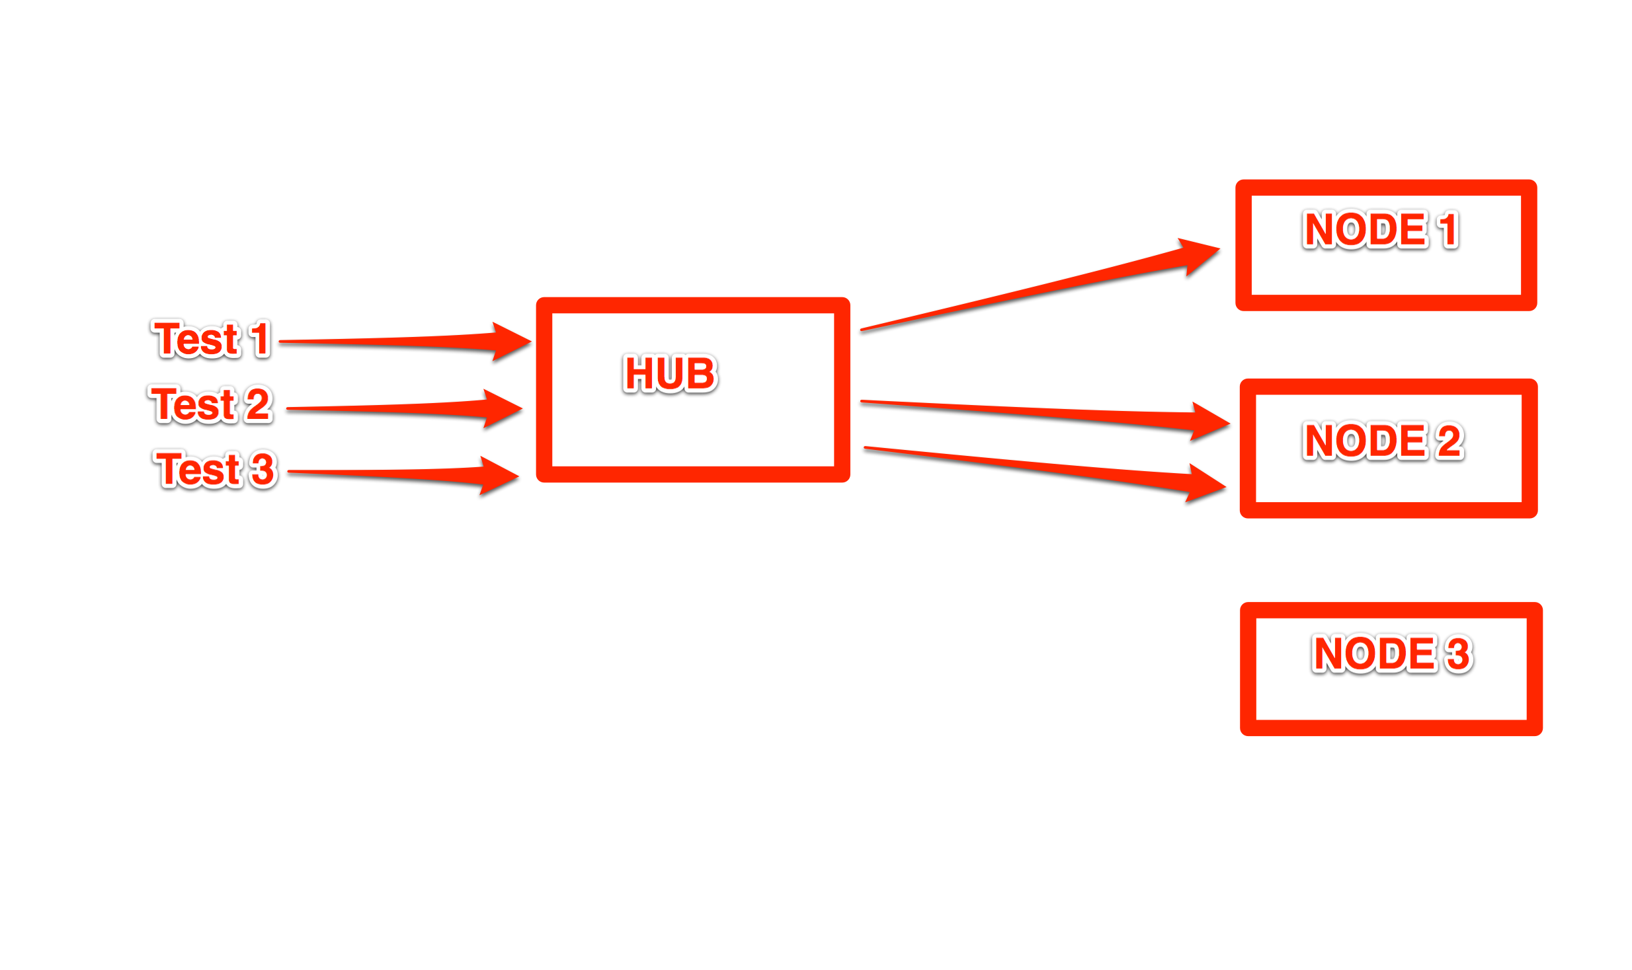

Slide 13
Session ID
Every test has a session unique session id
  3e6f47aa-16ec-4951-8c1f-3b17a4405247
Session ID is only way to identify each test request

Slide 14

Share Resources

Slide 15
Share Resources
Multiple teams can use same browsers
No need to purchase individual computers for each team

Slide 16
Getting Source Code
Git clone
  https://github.com/SeleniumHQ/selenium
Open with
  Inteli J
  Eclipse

Slide 17

Proxies

Slide 18
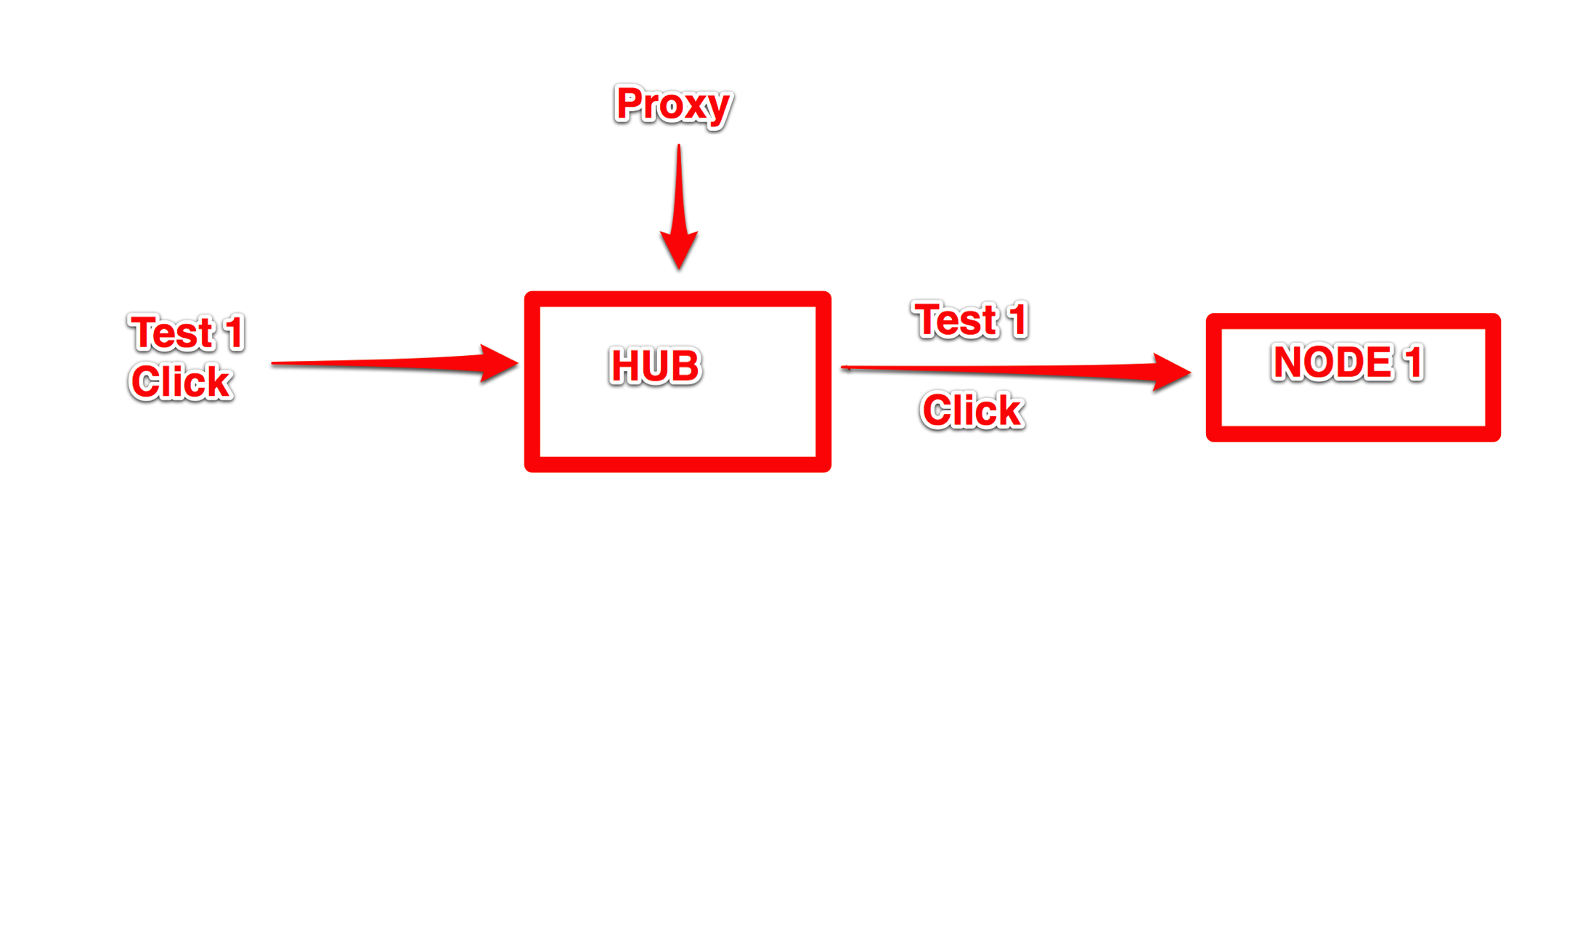

Slide 19
DefaultRemoteProxy.java
Passes commands from test
Interesting methods
    getNewSession()
    beforeSession()
    afterSession()
    beforeCommand()
    afterCommand()
    beforeRelease()

Slide 20
Selenium Grid Extras
Source Code
  https://github.com/groupon/Selenium-Grid-Extras

Slide 21
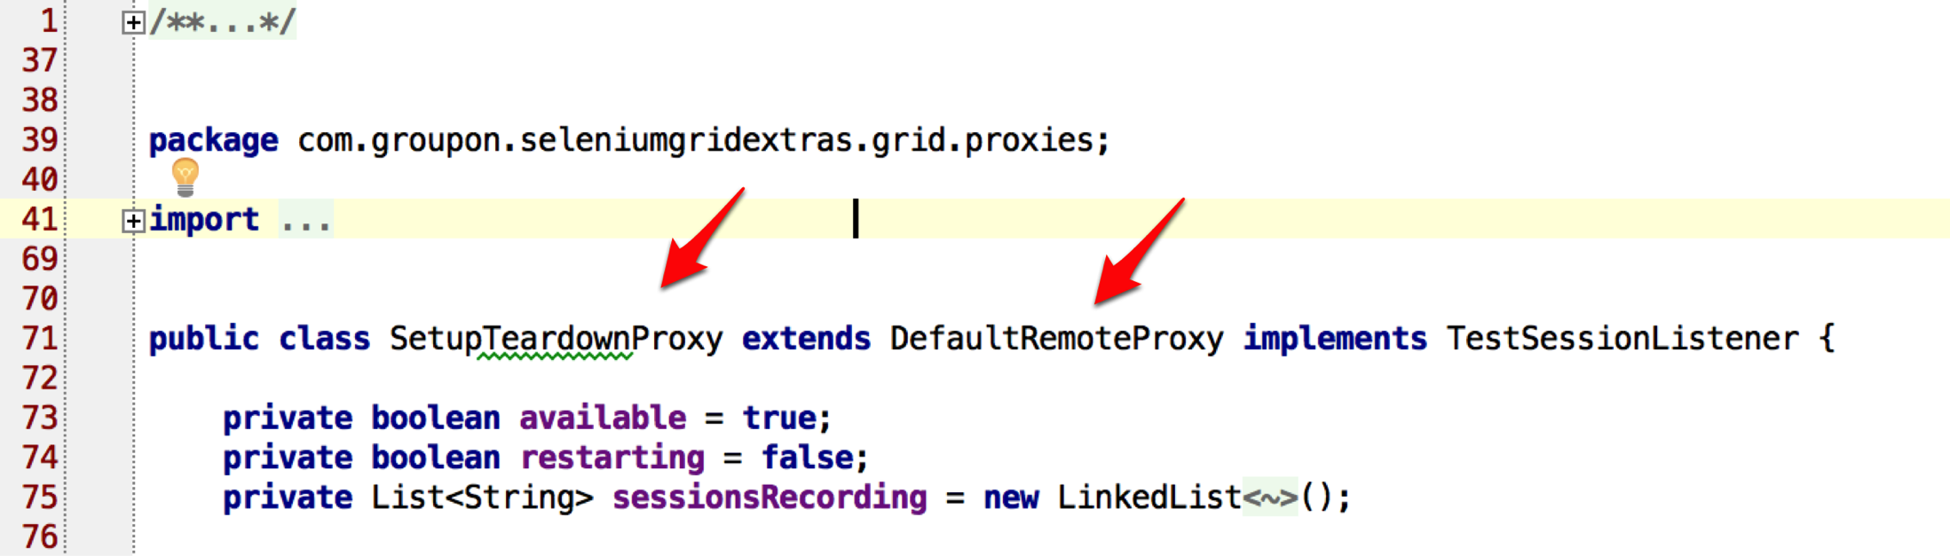
Overwriting Default Proxy

Slide 22
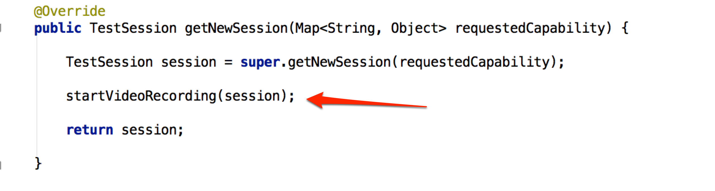
Overwriting Default Proxy

Slide 23

Why video record?

Slide 24
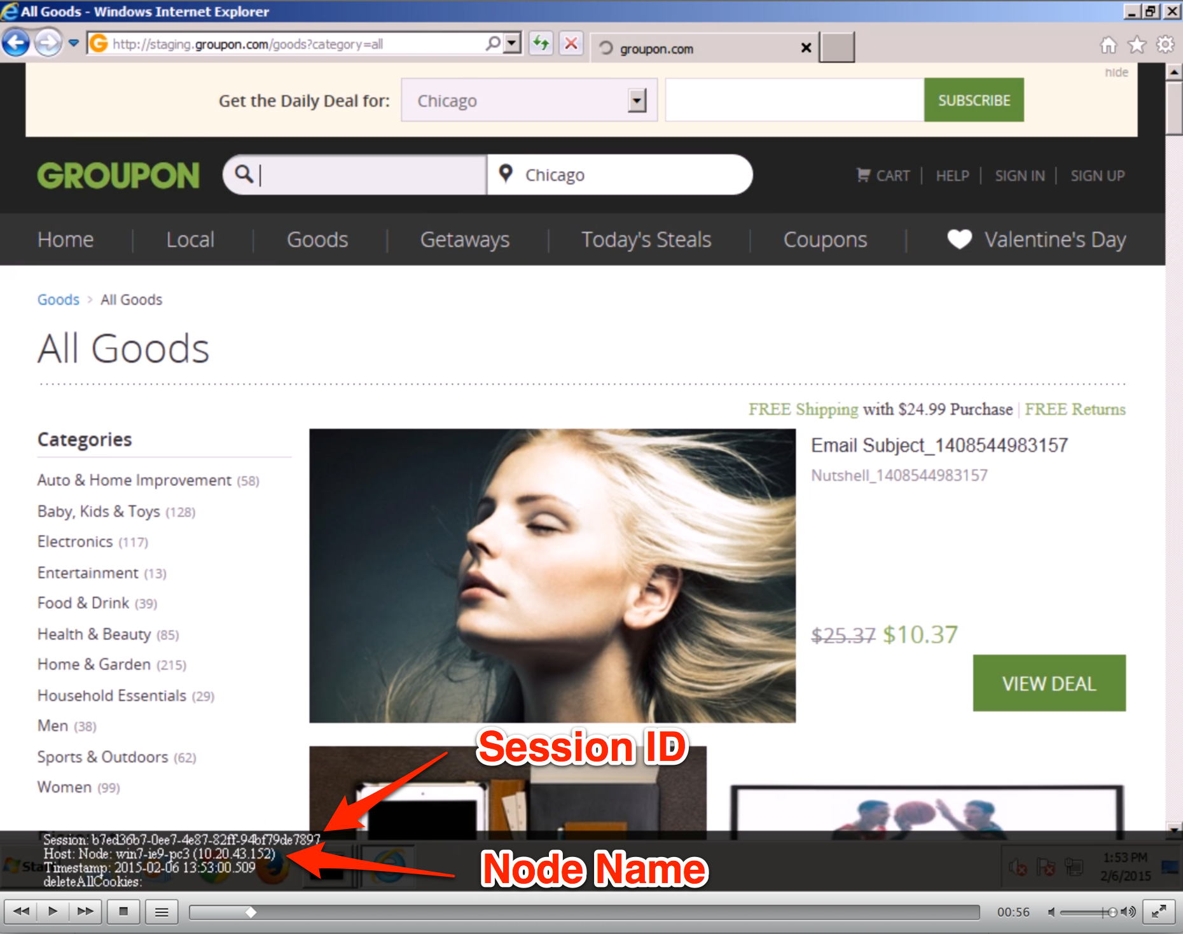

Slide 25
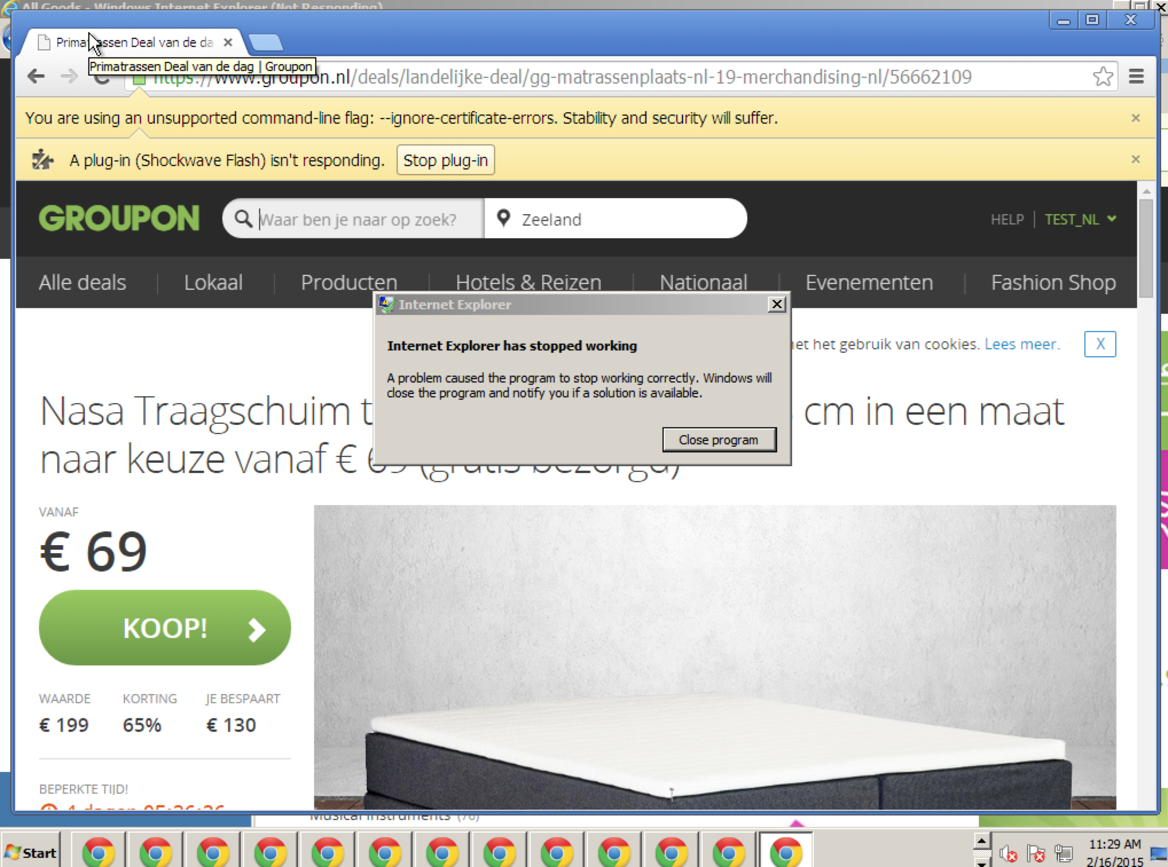

Slide 26


Slide 27
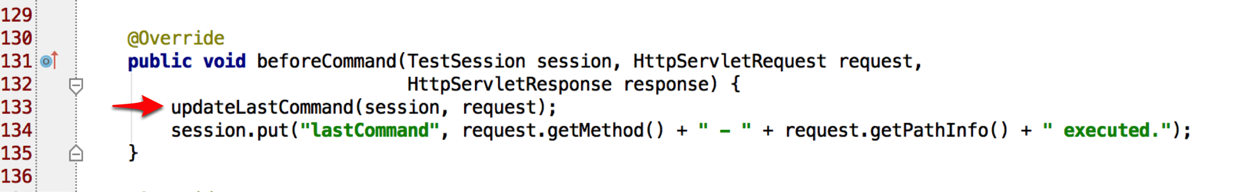
Before Command

Slide 28
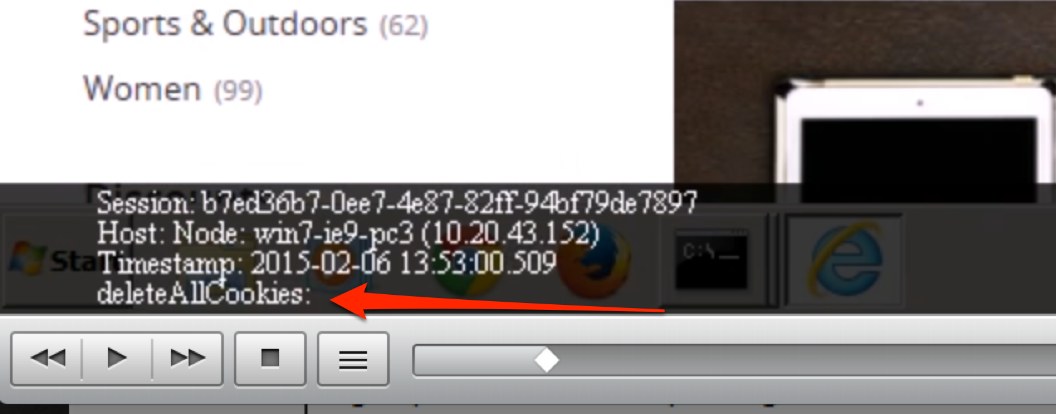

Slide 29
Adding New Proxy
Command Line
  “proxy” argument
Config JSON

Slide 30
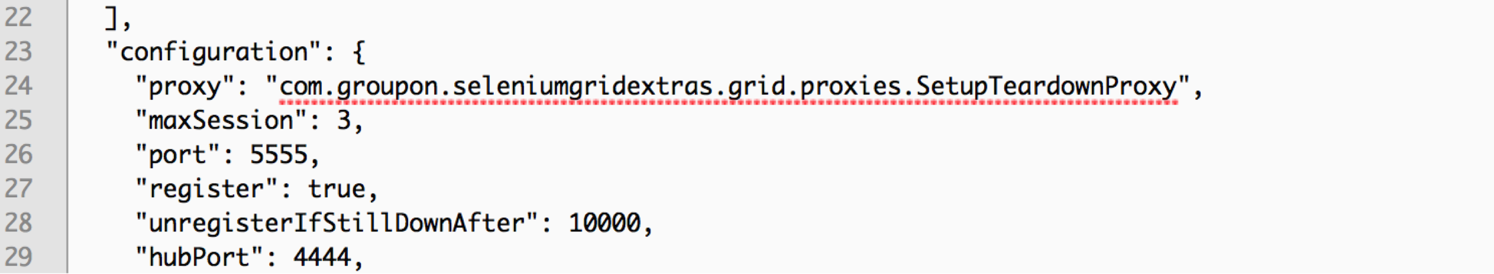

Slide 31
Special Note
Proxy to use config is defined on the node
The HUB needs to be in class of the HUB
Runs only on HUB instance!
Multiple proxies

Slide 32
Prioritizers
Default FIFO
  First In, First Out
Interface Class

Slide 33
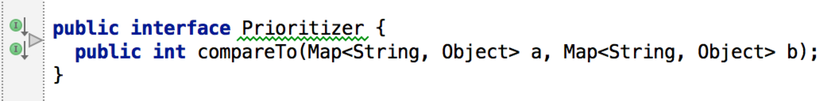

Slide 34
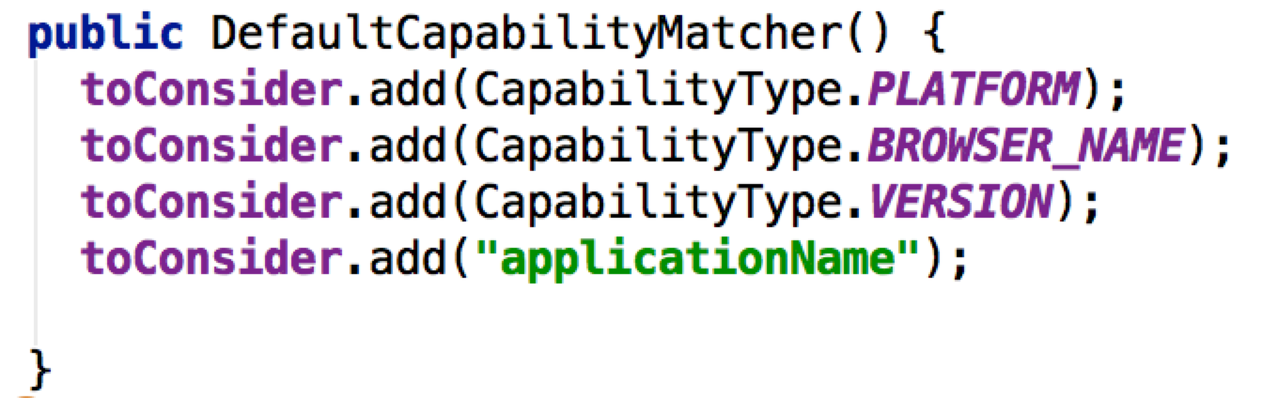
Capability Matcher

Slide 35
Capability Matcher
matches()
  Returns bolean

Slide 36
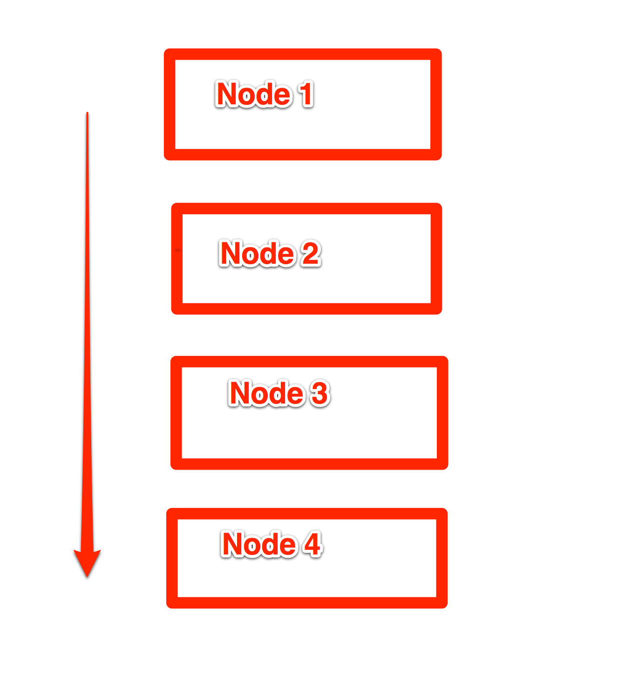

Slide 37
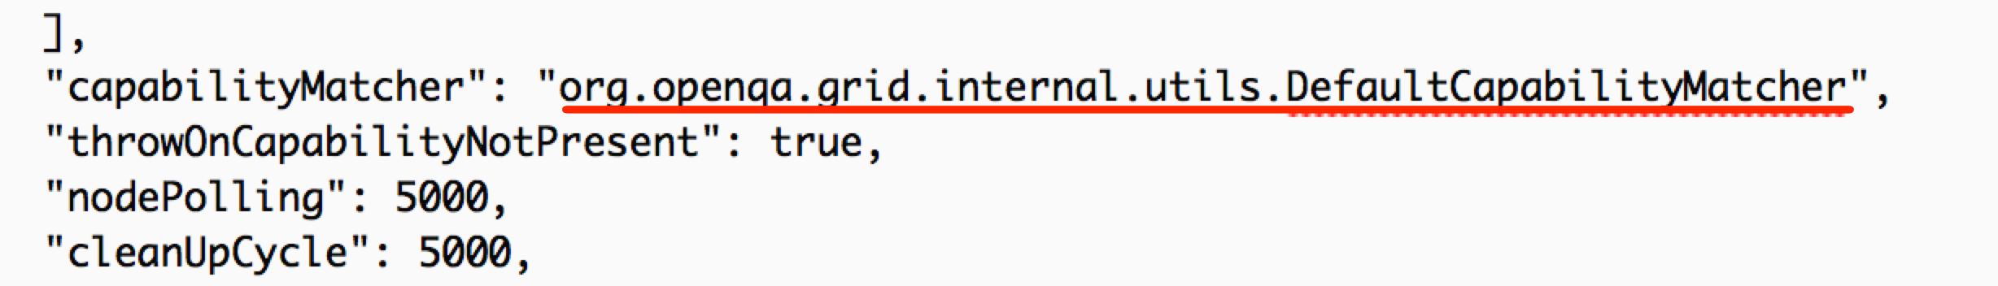
Config JSON

Slide 38
Servlet
Allows user to implement custom HTTP endpoints
Can be any valid HTTP format
  HTML
  JSON
  XML

Slide 39
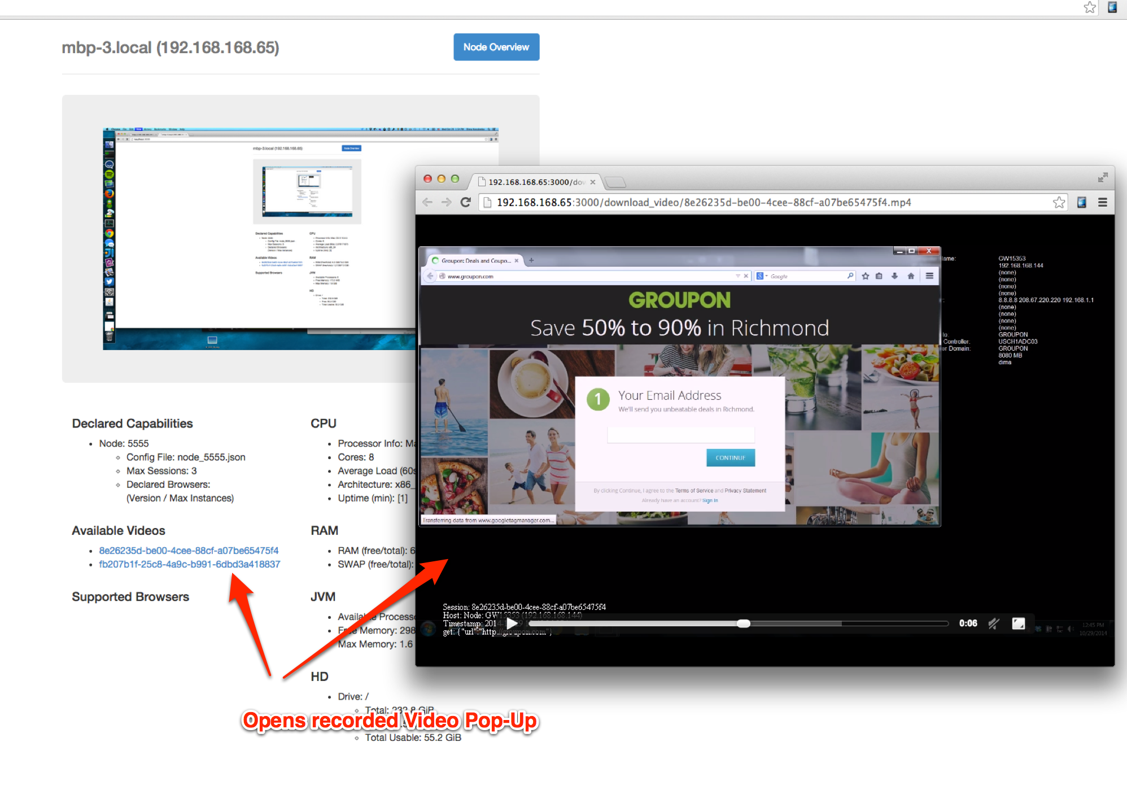

Slide 40
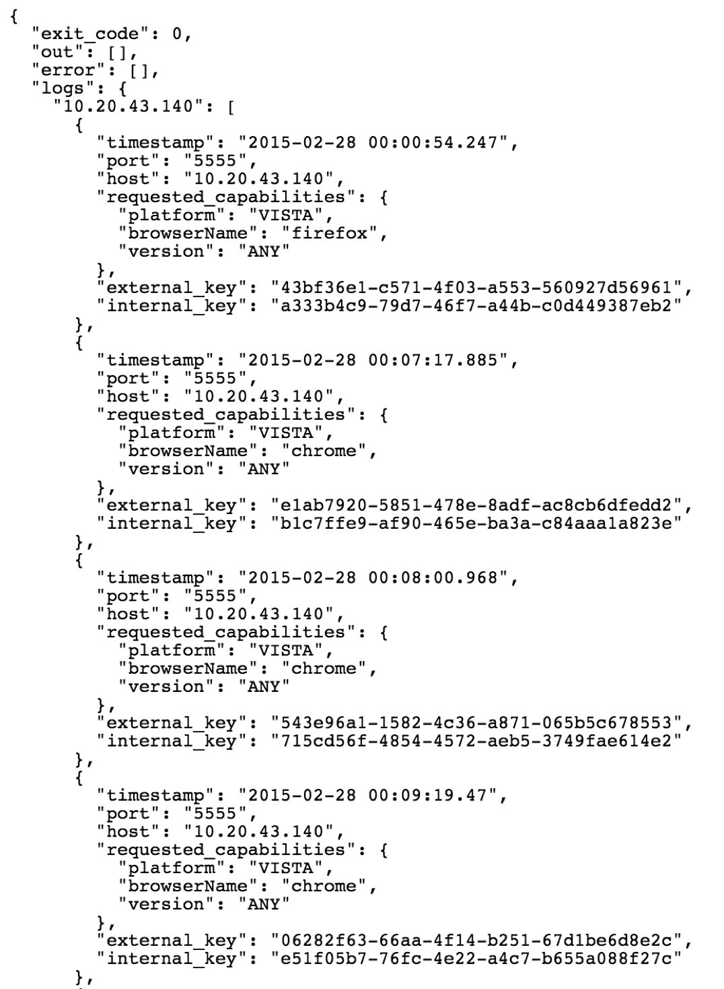

Slide 41
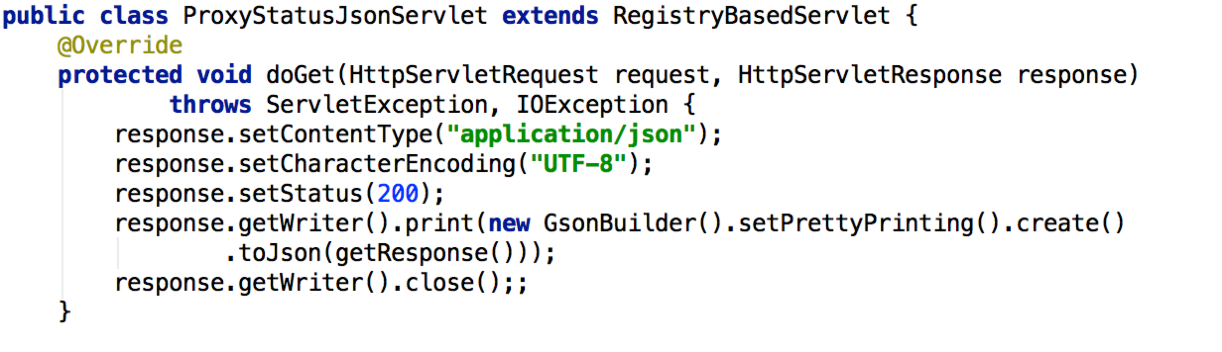

Slide 42
Compiling into JARs
Maven
Javac
Etc

Slide 43
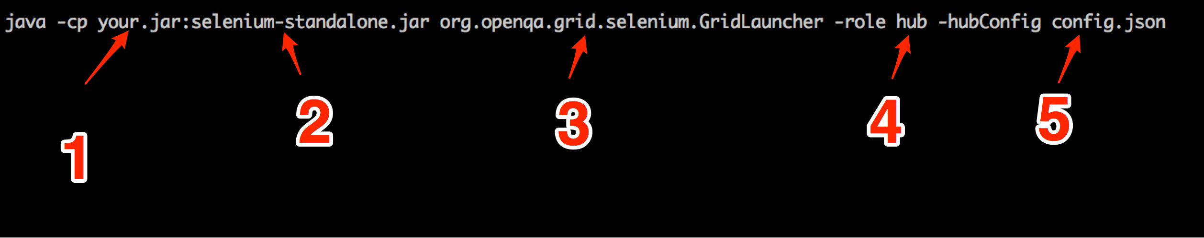
Classpath

