Slide 1
Be the Garbage Man of your team
Alex Kogon
Dima Kovalenko

Slide 2


Slide 3


Slide 4
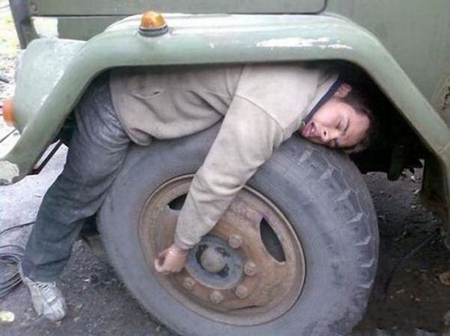

Slide 5
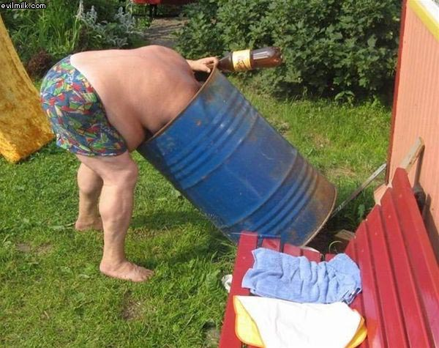
Let’s talk about Garbage

Slide 6
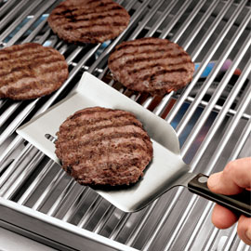
My first job

Slide 7
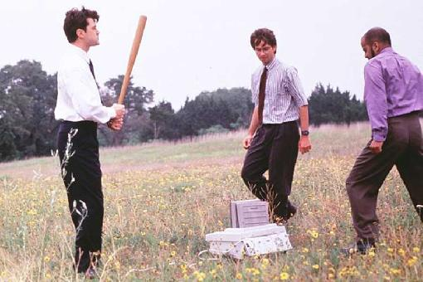
My second job
Manual testing

Slide 8
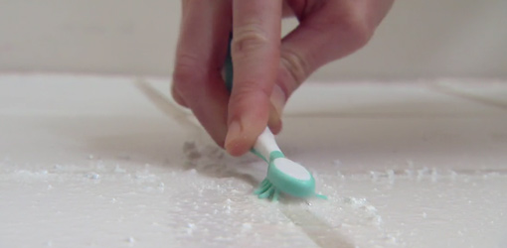
No one wants this job!

Slide 9
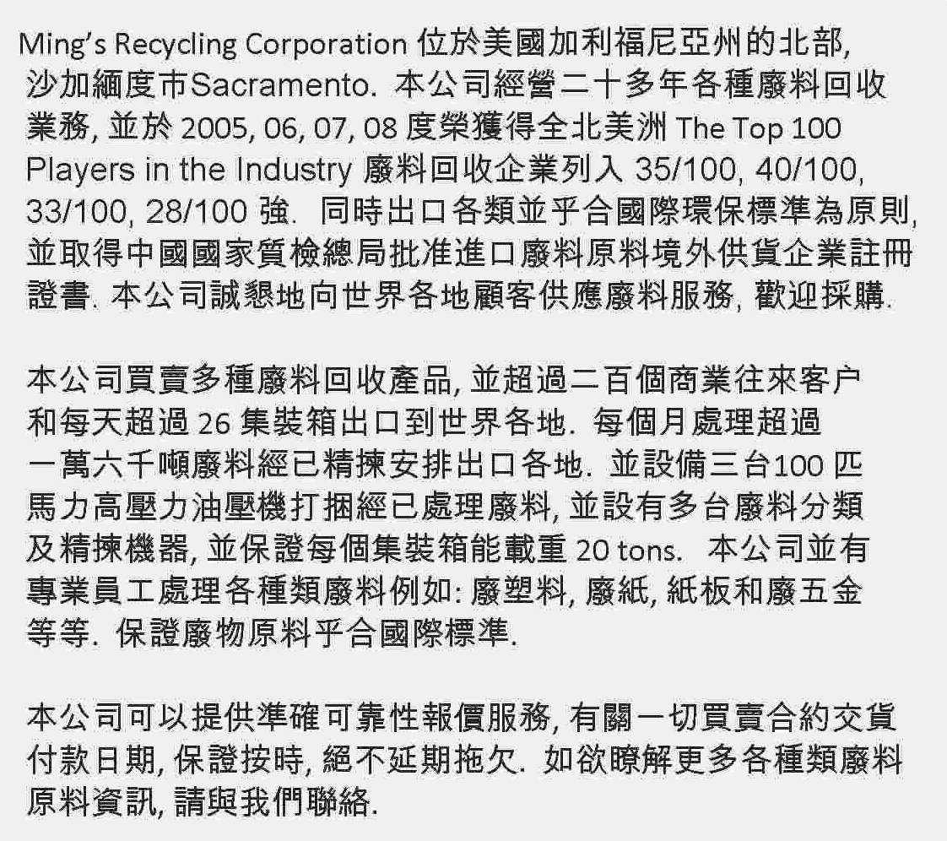

Slide 10
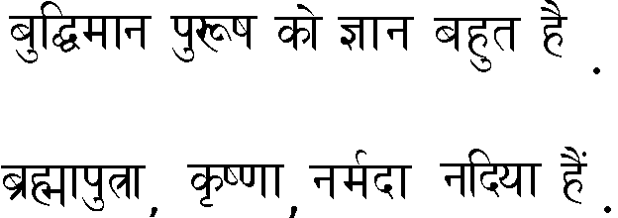

Slide 11
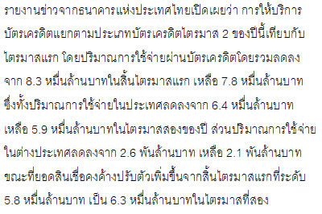

Slide 12
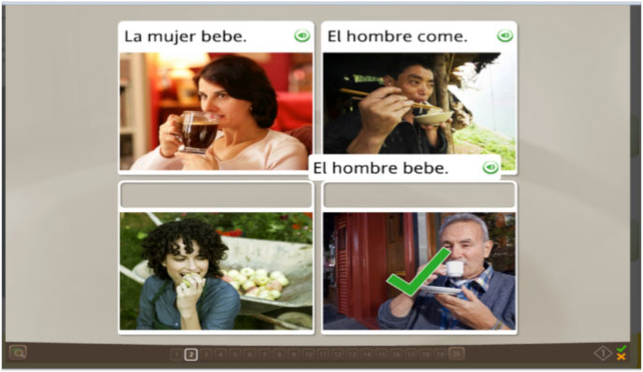

Slide 13
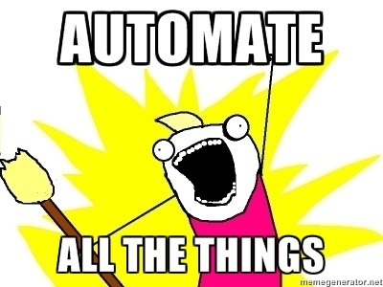
Solution
Perl script

Slide 14
Final Thoughts
Frustration is good
Automation is good
New skills are good

Slide 15
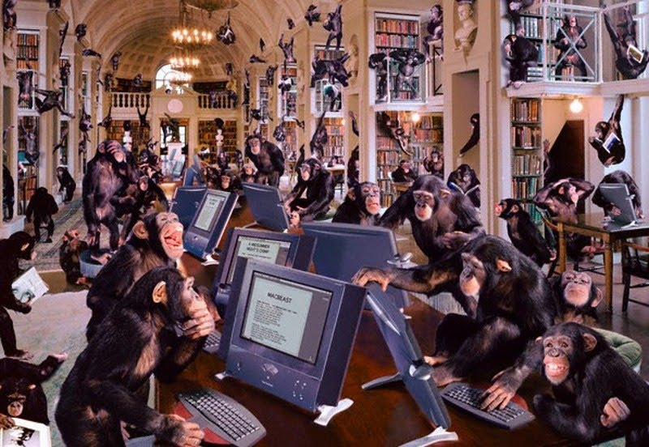

Slide 16
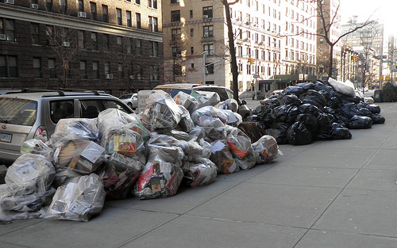
When we do things right, no one knows we exist!

Slide 17


Slide 18
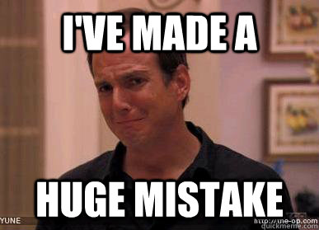

Slide 19
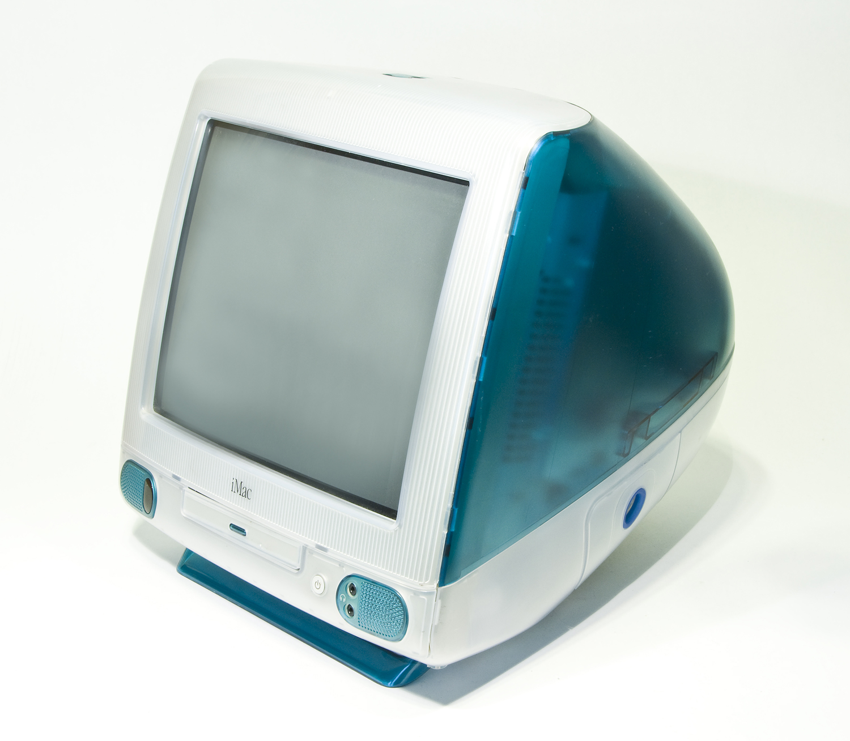

Slide 20


Slide 21
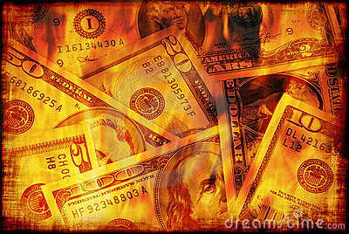

Slide 22
How I learned to be good by doing everything bad

Slide 23
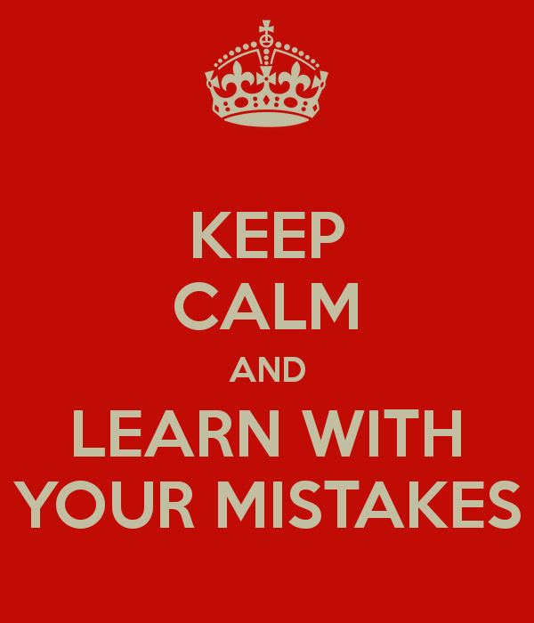

Slide 24

Case Study 1: University Work

Slide 25
Blackboard Coding
Short ugly variable names
Lots of theory
Lots of coding, little compiling (or testing!)

Slide 26

Result?

Slide 27

Start Over!
Start small, compile continuously
Test all the time, even the smallest things
Code with the debugger!

Slide 28

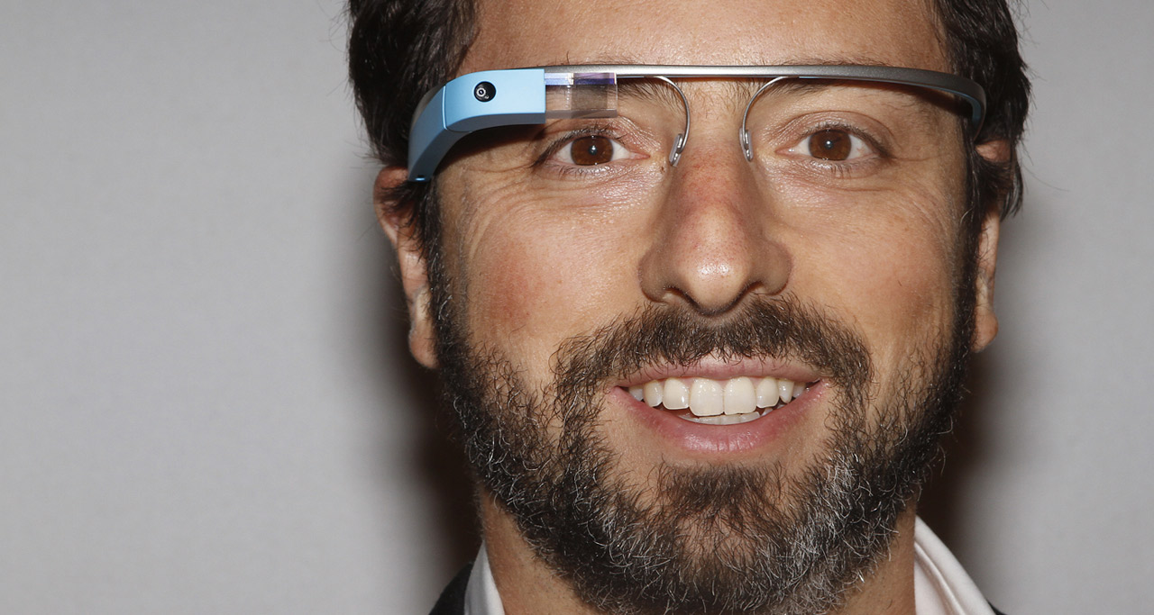
Times they are a…
vs

Slide 29
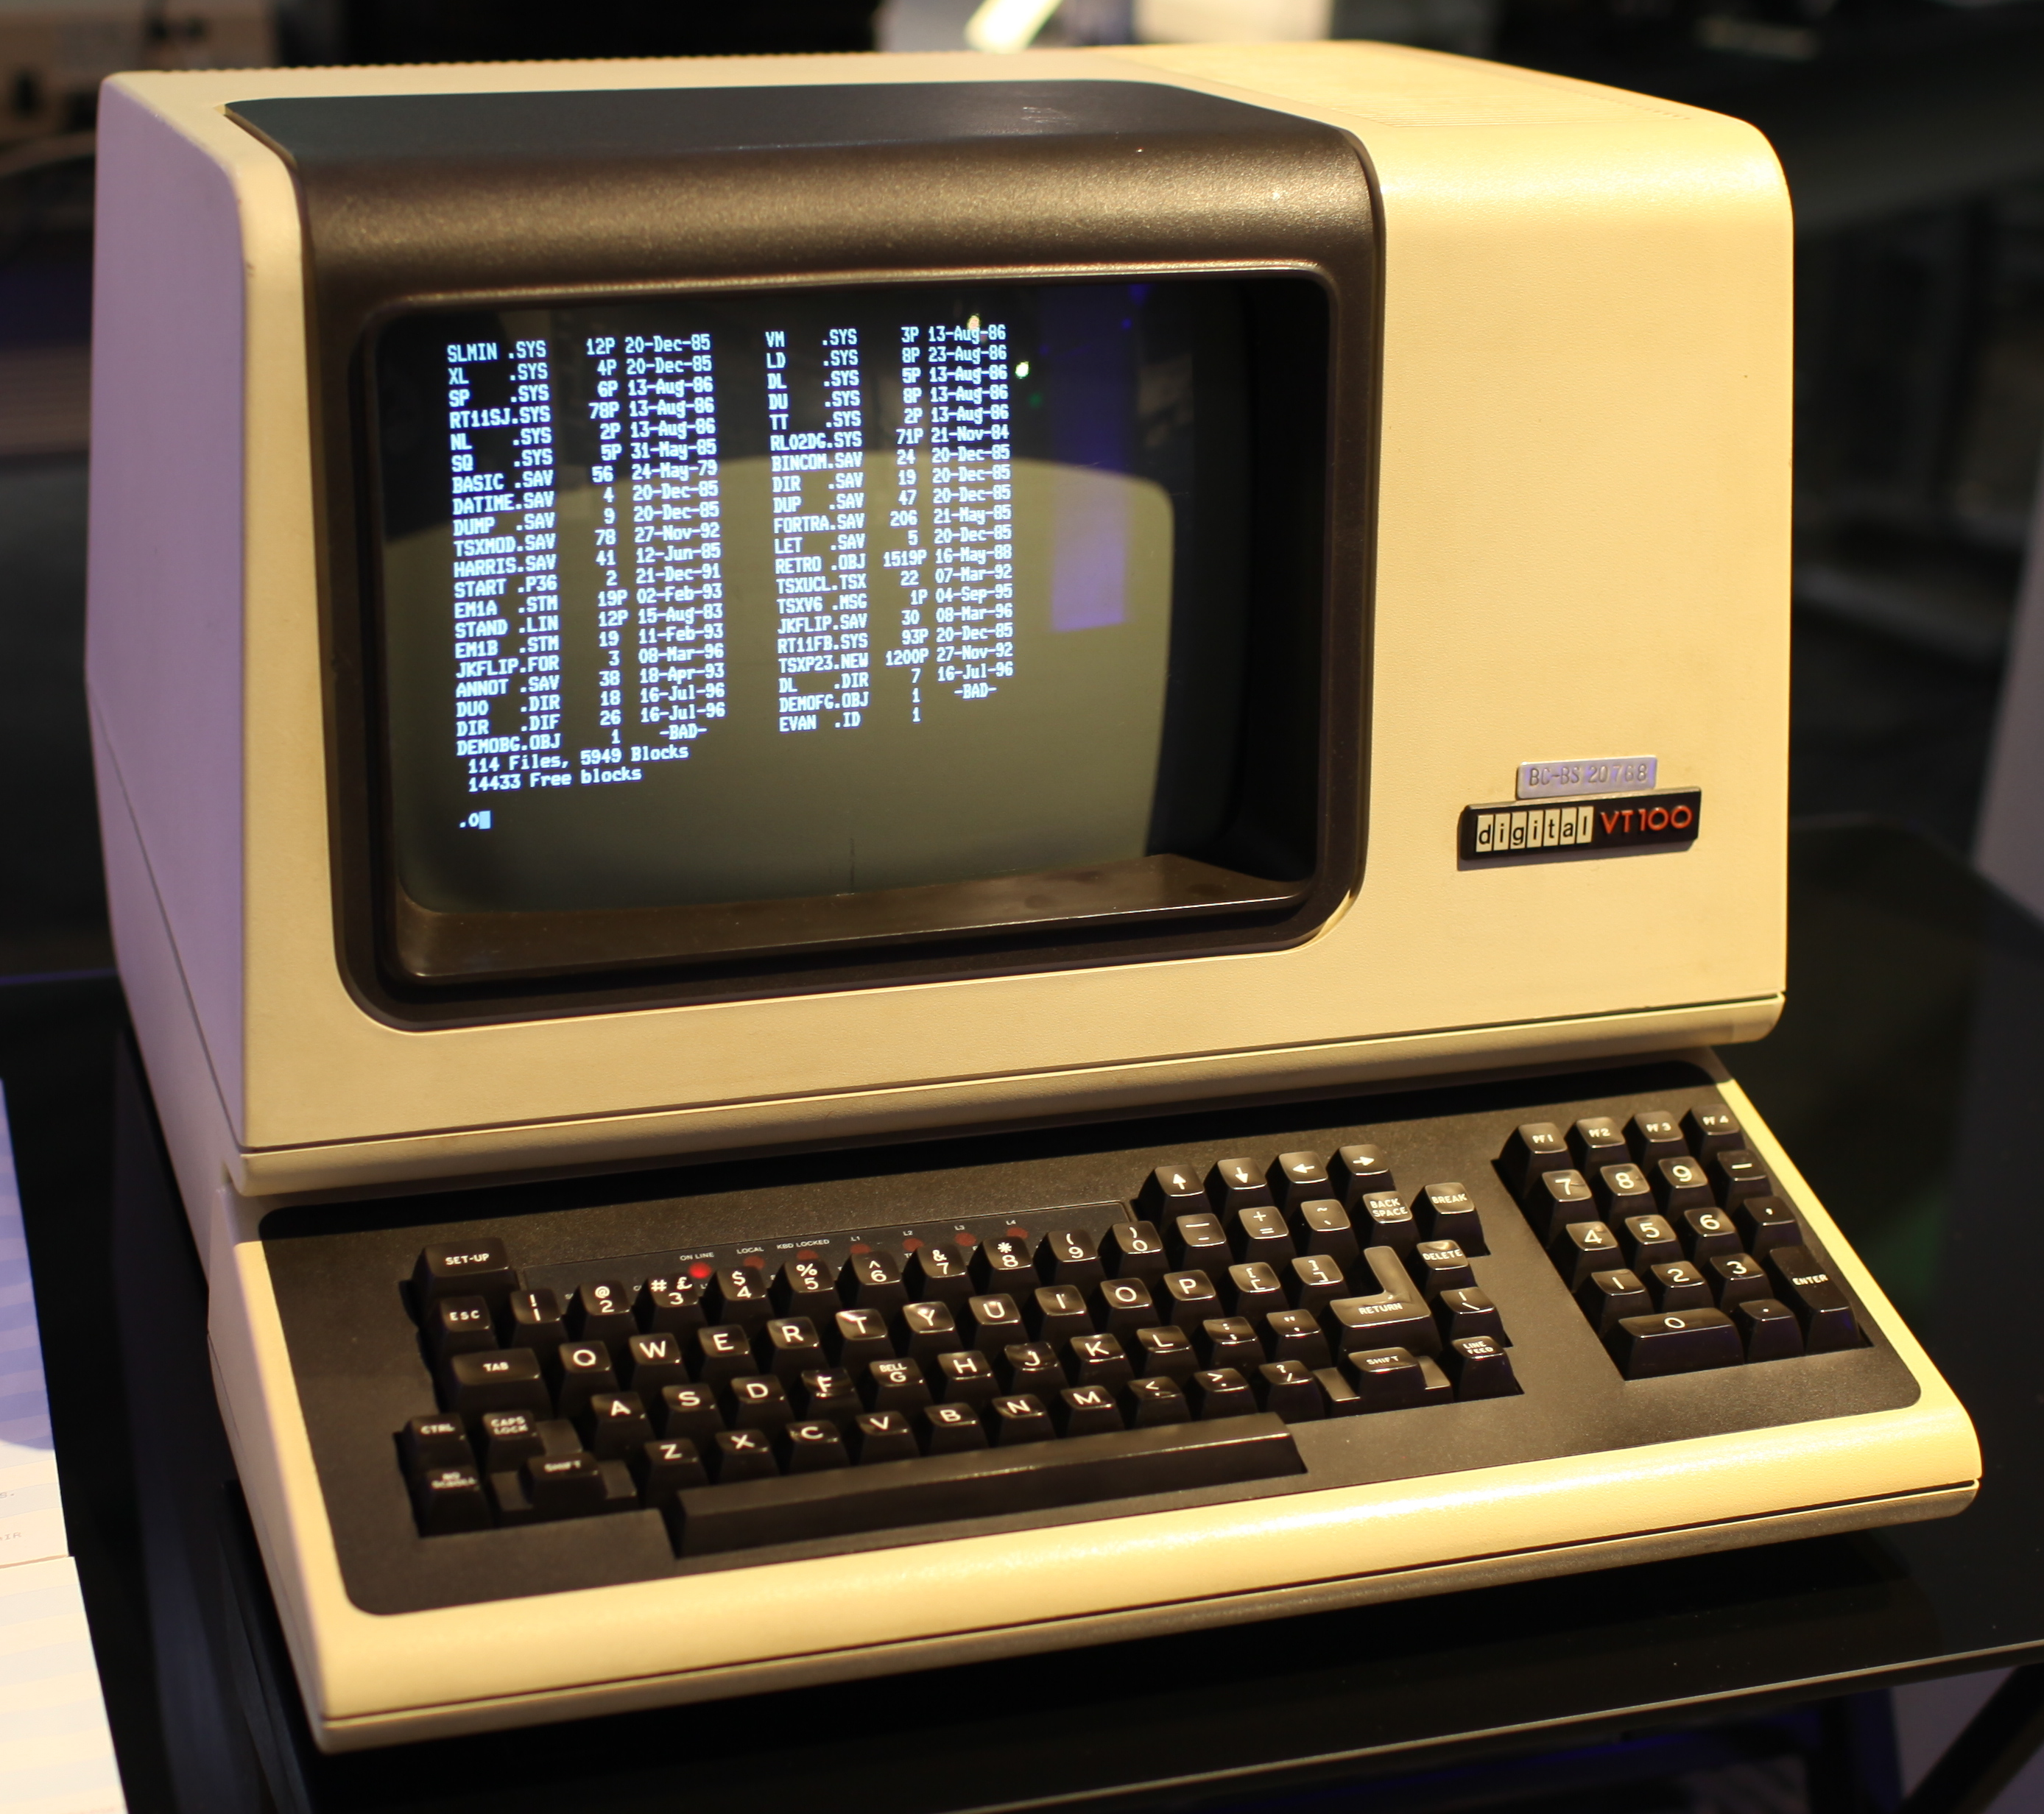


Slide 30
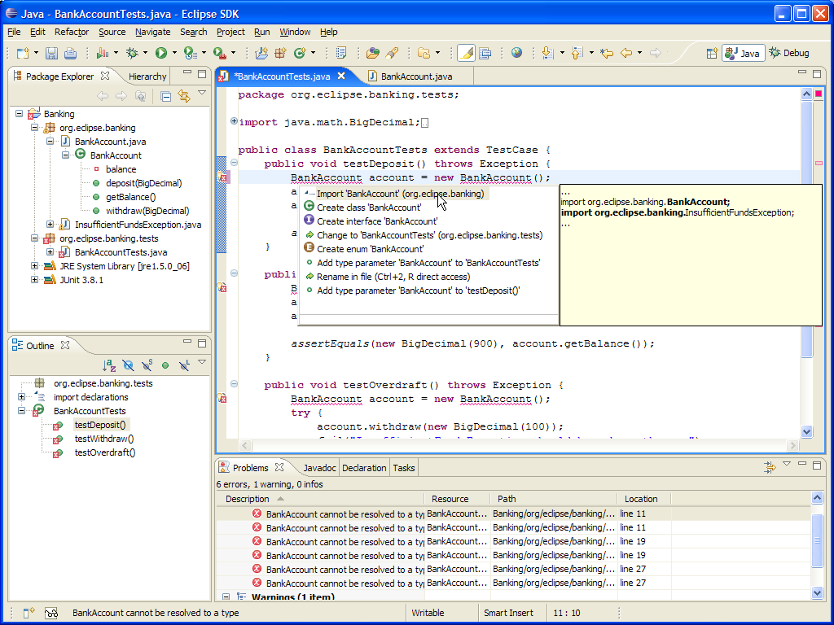
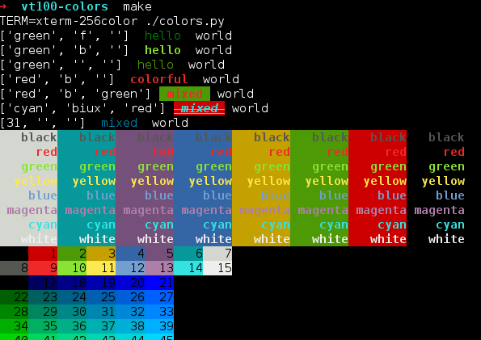

Slide 31
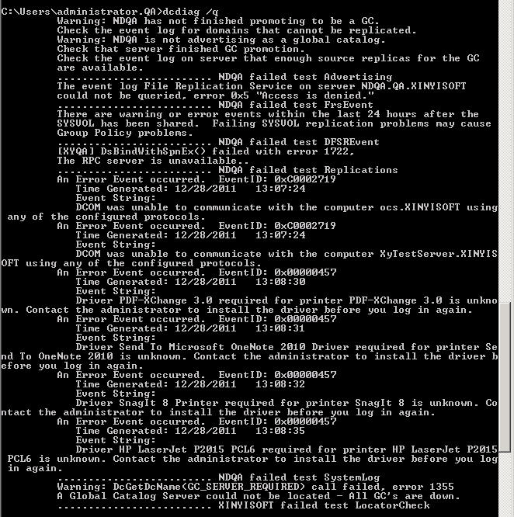
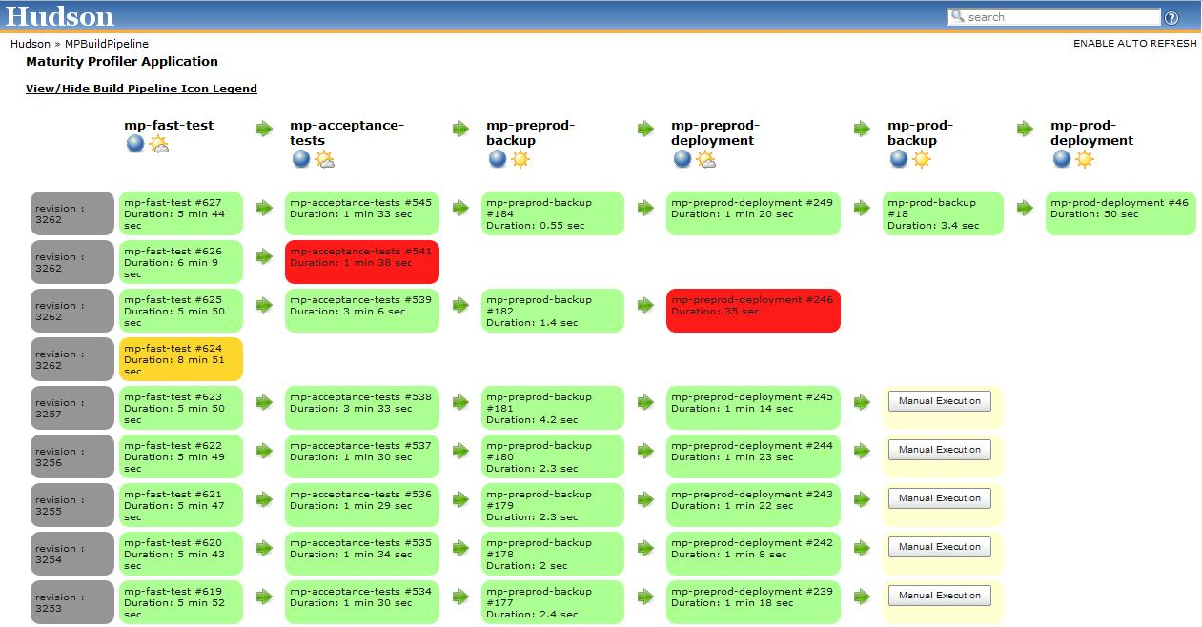

Slide 32
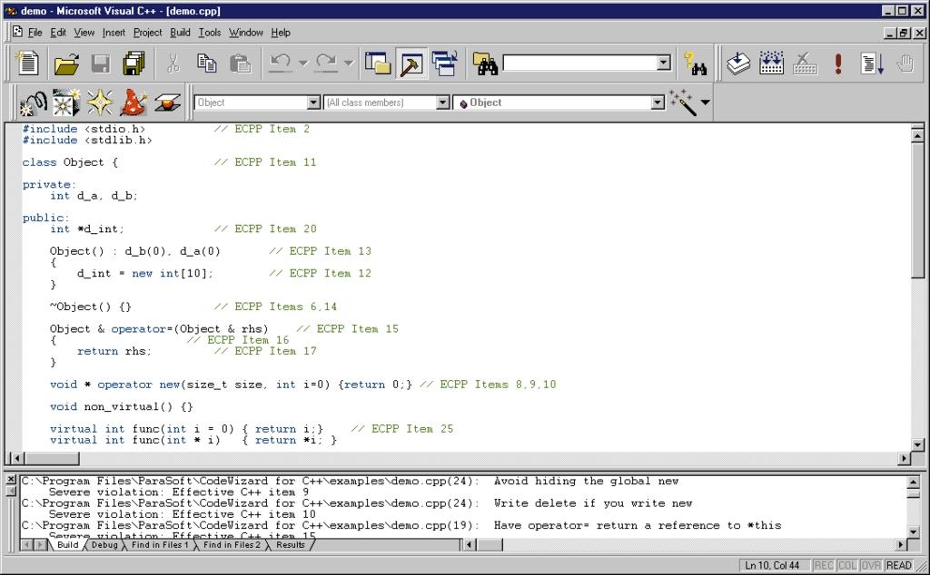
Case Study 2: Reengineering Old Code

Slide 33
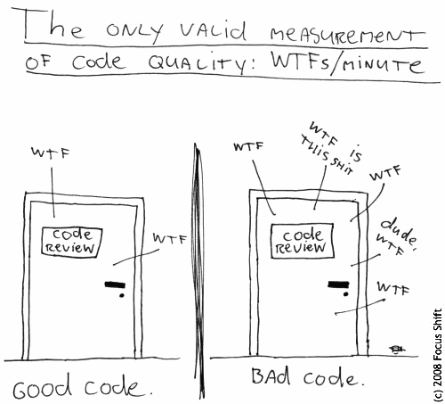

Slide 34
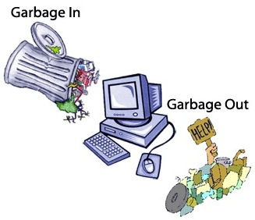

Slide 35


